Slide 1

Lesson Three Atoms and Isotopes
The Harnessed Atom

Slide 2
What you need to know about Atoms and Isotopes:
Matter
Molecules
Elements
Chemical reaction
Periodic Table
The Atom
Parts of an atom
Isotopes
Unstable isotopes
Scientists and discoveries

Slide 3
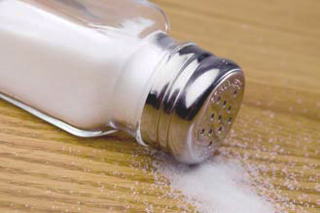
What is the smallest thing in your classroom?
Is it the dust under your desk?
Is it the salt that fell off your pretzels at lunch?
Maybe the smallest period you can make with your pencil?
No. Molecules are smaller. All the things you’ve thought of are made up of molecules!
Molecules are too small to see. Even with the most powerful microscope.

Slide 4
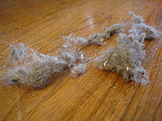
Are molecules the smallest?
No. Atoms are even smaller than molecules.
Molecules are made up of atoms.
Dust, air, water, people— everything is made of atoms.
Atoms are so small that it takes millions of them to make a speck of dust.
Example: If the pencil lead was all carbon, that little dot you make with your pencil has about 4 billion carbon atoms in it.

Slide 5
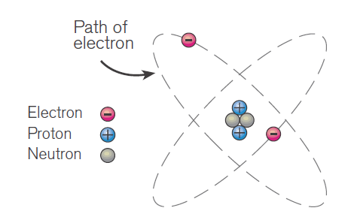
Are atoms the smallest?
No. Most atoms are made up of even smaller particles called
protons
neutrons
electrons.
Protons carry a positive electrical charge (+). Neutrons have no electrical charge.
Protons and neutrons together make a dense bundle at the center of an atom. This bundle is called the nucleus.
Electrons have a negative electrical charge (-) and move around the nucleus. Electrons are the smallest of these particles.
Notes:
Ask students to locate the nucleus in the illustration.
This illustration is the Rutherford-Bohr model. It provides a simple representation of the structure of an atom. Modern physics theory places the movement of electrons in a cloud of possible orbits around the nucleus. Some students may want to draw the atom now.

Slide 6
What to remember
Biggest
to
Smallest
molecule
atom
nucleus
protons
neutrons
electrons
Protons, neutrons, and electrons are all called particles.
Notes:
Reinforcement of these key terms may help students before we go on. Consider using Powerpoint to “white out” the answers above and encourage students to memorize the facts.

Slide 7
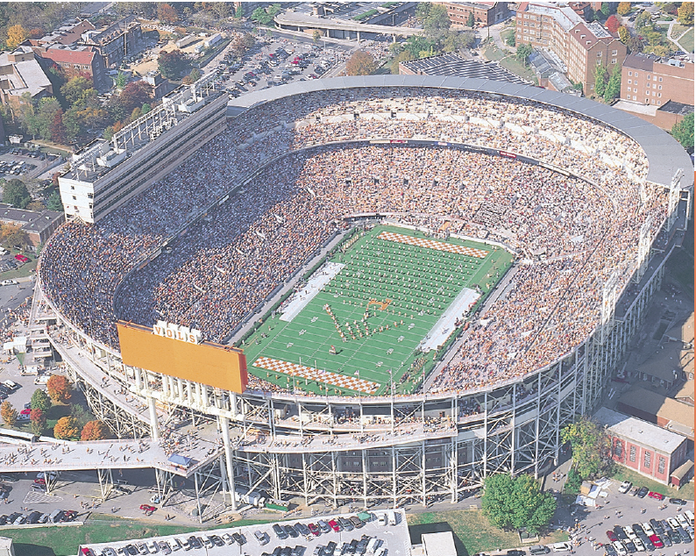
Empty space in atoms.
The particles that make up an atom are very small.
But imagine if you could enlarge an atom to the size of a stadium.
The nucleus would be about the size of a grape on the mid-field stripe.
Electrons would be smaller than grains of salt whirling around the upper deck.
Most of the atom would be empty space.

Slide 8
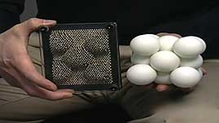
How do you know about atoms if you can’t see them?
Direct observation is something you see for yourself.
Indirect observation is learning by looking at what happens around the unseen. Scientists use indirect observation to learn about matter.
Example: You step out of the shower. Your wet feet leave footprints. An indirect observer might guess you made the footprints, based on the size of the prints.
Here’s a video clip that shows how scientists use indirect observation:
http://www.teachersdomain.org/resource/psu06-nano.sci.pictures/
Notes:
The technique some scientists use to observe individual atoms is similar to the technique of using touch to find out the size, shape, and location of objects in a dark room.
The clip above runs about 1 minute. Highlight the url with your cursor. Right click from your mouse to select “Open Hyperlink.” Click “view.” For this draft of The Harnessed Atom, you will have only 6 runs of this video.

Slide 9
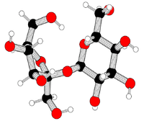
Studying individual atoms
Today, scientists have complex ways to study things they can’t see. But scientists have been using indirect observation for hundreds of years.
First, they learned most things are not made out of just one kind of atom. Instead, different kinds of atoms get together to form larger clumps of atoms called molecules.
Not all molecules are alike. A molecule of sugar is different from a molecule of salt.
Scientists started isolating molecules based on what type of atoms were in them.
Notes:
Ask students to imagine a tiny grain of table sugar (sucrose). A molecule of sucrose is structured like the drawing above. There are 45 atoms in 1 molecule of sucrose. 12 atoms of carbon, 22 atoms of hydrogen, and 11 atoms of oxygen.

Slide 10
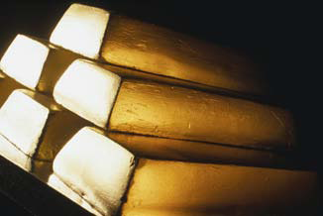
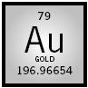

Elements are what they are.
Elements are the most basic parts of all matter that cannot be broken down into simpler substances using chemical reactions.
An element is a substance whose atoms all have the same number of protons.
Example:
Gold is an element. A bar of pure gold contains only atoms of one element, gold.
Long ago, this was the symbol for gold: Now we use: Au
Notes:
If a scientist from the United States were speaking to a scientist from another country, say, Italy, the Italian word for gold is oro. Both scientists, however, abbreviate gold the same way: Au. This is true internationally.
The Latin word for gold is aurum.

Slide 11
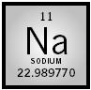
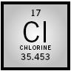
Atoms combine with other atoms.
Most things are made up of a combination of elements.
Example: A molecule of table salt has one atom of the element sodium and one atom of the element chlorine.
Notes:
Ask students if they know what “H₂O” is. Explain that a molecule of water has atoms from two elements: hydrogen and oxygen.

Slide 12
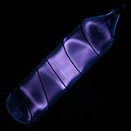
Periodic Table of the Elements
As scientists started indirectly figuring out things about elements, like how heavy they are or how common they are, they started sorting them into a table.
The Periodic Table of the Elements can tell you for each element
Whether it’s a solid, liquid, or gas
How many protons it has in its nucleus
Interactive periodic table of the elements:
http://periodic.lanl.gov/index.shtml
Photographic periodic table:
http://periodictable.com/
Notes:
Highlight the url with your cursor. Right click from your mouse to select “Open Hyperlink.” Click an element. Hydrogen is a good one to start with. Point out its atomic number is 1, its symbol is H, and let them tell you who discovered it and when. The photograph here is a vial containing ultrapure hydrogen gas. Hydrogen is a colorless gas that glows violet when ionized.
Show your students how the periodic table looks in other languages at http://www.ptable.com/?lang=it . If you have any bilingual students, they may be especially interested in this tool.

Slide 13
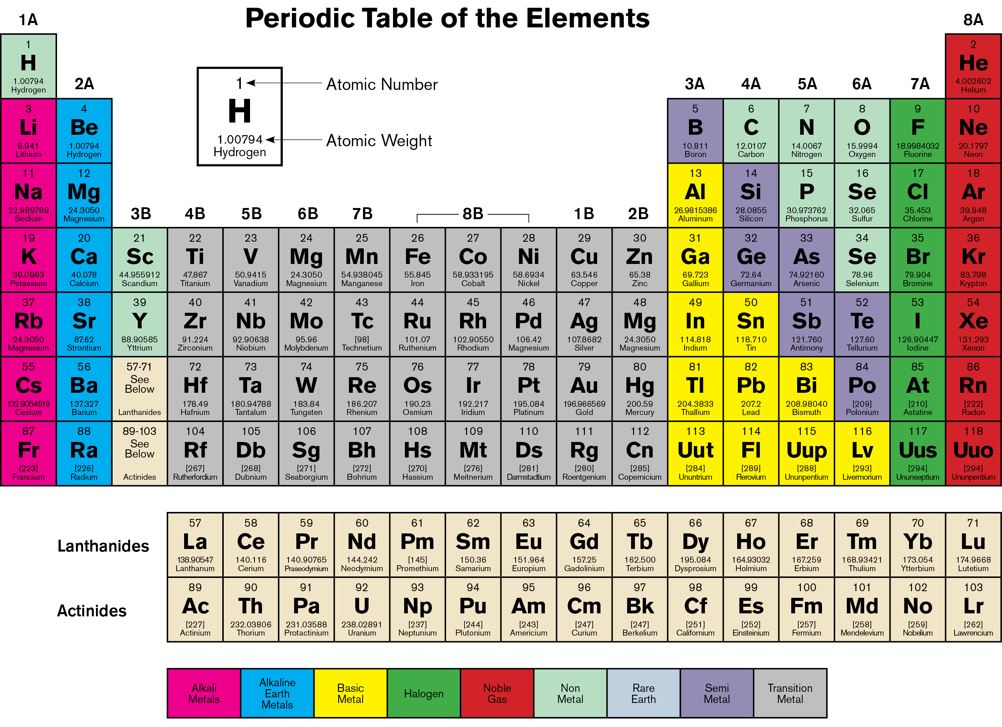
Periodic Table of the Elements
Notes:
Activity 1: Ask students to take a look at the Periodic Table.
How many elements can they name?
How many protons does hydrogen have? (1) gold? (79) zinc? (30)
What color are the gases on this chart? (red)
Note: We know for sure 92 elements exist in nature. Physical evidence indicates that at least two others are present from time to time because they are part of the decay chain of some naturally occurring elements. Students may become confused because the period table indicates 103 elements (or more, depending on how current the version). The reason for the discrepancy is that scientists have produced small amounts of very heavy elements in the laboratory and not all tables show them.

Slide 14
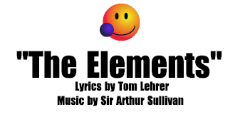
Play the elements
The periodic table displays the chemical elements. Here is fun way to remember them.
http://www.teachertube.com/viewVideo.php?video_id=145369
Notes:
The tune and animation clip in Flash Animation above lists the elements in less than a 1.5 minutes. Highlight the url and right click to choose “Open Hyperlink.”
Ask your students to try to sing along when you play it again.

Slide 15

What is an isotope?
The nucleus in every atom of an element always has the same number of protons. However, the number of neutrons may vary.
Atoms that contain the same number of protons but different numbers of neutrons are called isotopes of the element. We total the number of protons and neutrons to name the isotope.
Example:
Let’s say your family name is Uranium. In your family, everybody has 92 protons.
Your brother has 143 neutrons. His name is uranium-235. (92 + 143 = 235)
You have 146 neutrons. Your name is uranium-238.
Your big sister has 142 neutrons. What is her name?
Notes:
Big sister’s name is uranium-234. Ask students: How did uranium-238 get its name? (Added 92 protons + 146 neutrons = 238) All three siblings in this analogy are isotopes of the element uranium. [Family = element; Siblings = isotopes] You may want to go back to the Periodic Table and point out the protons are identified for that element in the table.
Naturally occurring uranium is composed of three major isotopes, uranium-238, uranium-235, and uranium-234. All three isotopes are radioactive and create radioisotopes as they decay. The most abundant and stable is uranium-238.

Slide 16
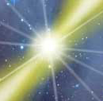
What is the strongest force known in nature?
Some proton-neutron combinations are more stable than others.
Stable combinations are not likely to change.
Unstable combinations are likely to change at some time.
Elements with unstable isotopes can change suddenly, releasing energy.
And although all atoms are extremely small, the energy that holds their centers together is the strongest force known in nature.
Notes:
How do the weak force and strong force help explain why such an enormous amount of energy is released when these forces are broken? Answer: The repulsive Coulomb’s force (weak force) and the nuclear strong force are the two strongest forces in nature. Even gravity is negligible by comparison, being 1029 times weaker. This helps explain why such an enormous amount of energy is released when these forces are broken.)
Comparison: When a stretched rubber band breaks, the energy that it held is suddenly released. You can’t see this energy, but you can see the effect on the rubber band, which often shoots across the room. Sometimes similar things happen when unstable isotopes break down and new bonds are formed. An invisible energy is released. And although all atoms are extremely small, the energy in their centers is the strongest force known in nature. It is called the strong force. When the strong force is broken and a new bond is formed, the energy that is released is quite powerful.

Slide 17
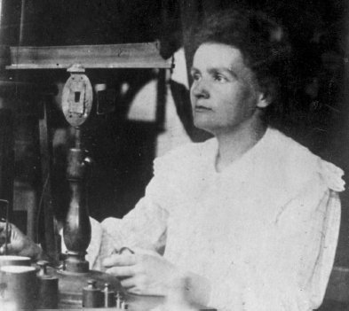
Who discovered the energy of atoms?
Scientists from around the world ran experiments and realized the atom contains large amounts of energy.
Wilhelm Roentgen discovered an invisible energy he called an x ray. (1895)
Henri Becquerel observed that uranium gave off similar energy. (1896)
Marie Curie studied uranium rays and discovered radioactivity as energy from within the atom. (1898)
Ernest Rutherford understood the “enormous energy” of such matter. (1904)
Many other scientists have contributed to our knowledge of elements and atoms.
Notes:
Nuclear scientists have come from many countries and have included both men and women. Some have been honored by having elements named after them.
Photo is of Marie Curie in a Paris laboratory, dated circa 1905.

Slide 18
Summary
Atoms are the smallest units of matter that have all the characteristics of an element. Atoms combine to form molecules. Atoms are composed of smaller particles known as protons, neutrons, and electrons.
Protons have a positive electrical charge, neutrons have no electrical charge, and electrons have a negative electrical charge.
Protons and neutrons together form the nucleus or central mass of the atom. Electrons move around the nucleus.
The nucleus of each atom of an element contains the same number of protons, but the number of neutrons may vary.
Notes:
The answers are in the sentences above. You can turn this page into an activity using your cursor to highlight the blank spaces. Use your toolbar to make the answers’ font not white.
Review these facts with students before or after a quiz.

Slide 19
Summary
Isotopes of an element are identified by adding the number of protons and neutrons together and writing the sum by the chemical symbol for the element.
The energy that holds the nucleus of an atom together is the strongest force known in nature.

Slide 20
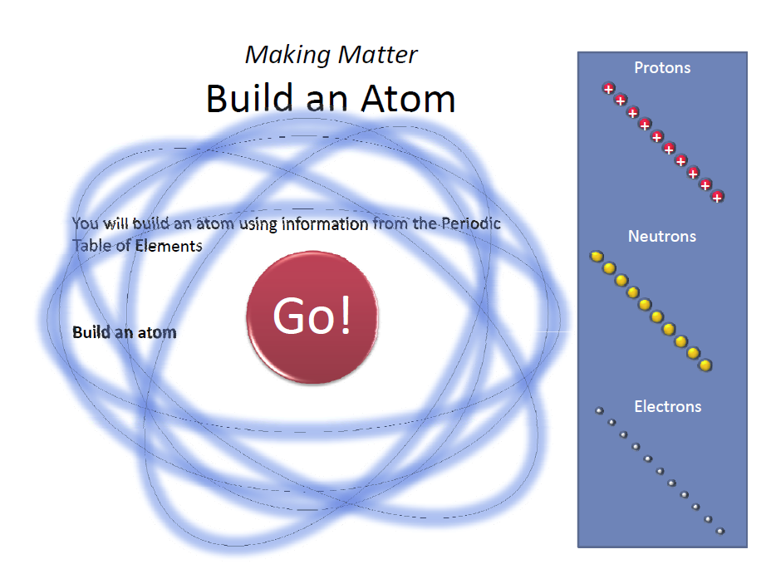
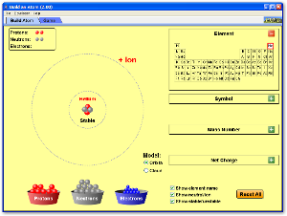
Advanced Student Assignment: Making Matter: Build an Atom
Interactive game on CD:
Online interactive game:
http://phet.colorado.edu/en/simulation/build-an-atom
Notes:
The activity on the CD uses Flash, which is not supported on Mac. The online interactive game uses Java.
Using information from the Periodic Table, students use the basic building blocks of matter to build chemical elements.

Slide 21
Vocabulary
atom – the smallest part of an element that has all the properties of that element
chemical reaction – a process in which the make-up of a substance is changed to form another substance; a process that involves changes in the structure and energy content of atoms, molecules, or ions but not their nuclei
electron – the smallest existing particle with a negative electrical charge; one of the three basic types of particles that make up an atom; particles that orbit the nucleus of an atom
element – one of more than 100 simple substances that cannot be chemically broken down and of which all matter is composed
emit – to send out or put forth; shooting out

Slide 22
Vocabulary
isotopes – atoms of the same element that have equal numbers of protons but different numbers of neutrons; examples are uranium-235 and uranium-238
mass– the amount of matter that makes up an object
matter– every substance that takes up space; something physical
molecule –the smallest part of a substance that keeps all the characteristics of a substance and is composed of one or more atoms
neutron – a particle that appears in the nucleus of all atoms except hydrogen atoms; one of the three basic particles that make up the atom; has no electrical charge
nuclei – the plural form of nucleus
nucleus – the central part of an atom that contains protons, neutrons, and other particles

Slide 23
Vocabulary
proton – an extremely small particle or bit of matter located in the nucleus and carrying one positive charge of electricity; one of the three particles that make up an atom
stable isotope – an isotope that does not undergo change
strong force – the strongest known force; the interactions within the nucleus of an atom that hold its nucleus together
unstable isotope – a radioactive isotope that will undergo change

